Slide 1

[Samsung PRISM] Monthly Connect
AI/ML: Age,Gender and emotion detection from speech
Team
College Professor(s):
1) Dr J Selvin Paul Peter, Associate Professor, Department of Computing Technologies, selvinpj@srmist.edu.in
2)Dr P Murali, Associate Professor, Department of Computing Technologies, muralip@srmist.edu.in
Students:
Rishabh Agrawal / ra7546@srmist
Raghav Khanna / ri9320@srmist.edu.in
Aaryaman bajaj / an1143@srmist.edu.in
Nilanjana Bhattacharya / nb2168@srmist.edu.in
Department: Cse Core (Computing Technologies)

Slide 2
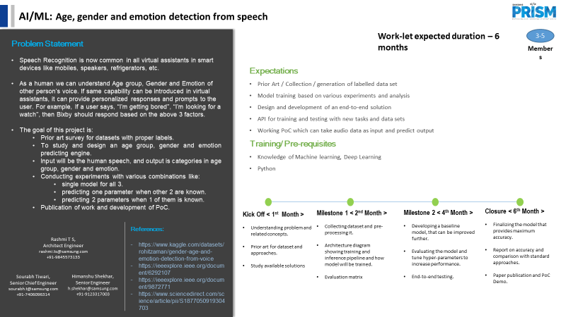

Slide 3
Work-let Name :- AI/ML: Age, Gender and emotion detection from speech
Worklet Details
Worklet ID: 23VI26SRM
College Name: SRMIST
KPIs Achieved Till Now
Problem definition :- In this project, we aim to develop a machine learning model that predicts a person's age, gender, and emotion using their voice as input. Voice carries a wealth of information, including vocal characteristics and emotional cues, which can be harnessed to make accurate predictions about the speaker. The objective is to leverage the power of machine learning techniques to create a robust and versatile system capable of extracting meaningful insights from voice recordings.
Data Collection and study
Data exploration
Date: 16/08/2023

Slide 4
Work-let Name :- AI/ML: Age, Gender and emotion detection from speech
Coverage of Key Concepts
Diversity of Sources
Discussion of Bias and Fairness
Use of Recent Literature
Effective Citations
Collaboration and Feedback

Slide 5
Any Challenges/ Issues faced
Work-let Name :- AI/ML: Age, Gender and emotion detection from speech
Rapidly Evolving Field:
Speech analysis, particularly in deep learning, is rapidly evolving.
New techniques, models, and datasets are frequently emerging.
Keeping up with the latest advancements can be challenging.
Variability in Approaches:
Researchers employ diverse methodologies, features, and models.
Comparing and evaluating techniques becomes complex due to variability.
Understanding the pros and cons of different approaches is essential
Lack of Standardized Datasets:
Limited availability of standardized, well-annotated datasets.
Combining various datasets may introduce data heterogeneity
- Addressing data quality issues becomes important for reliable results.

Slide 6
Work-let Name :- AI/ML: Age, Gender and emotion detection from speech
Bias and Fairness:
Research on bias and fairness is crucial in gender, age, and emotion detection.
Identifying potential biases in data, features, and models is vital.
Ensuring ethical considerations and minimizing bias is a key project goal.
Cross-Cultural and Linguistic Differences:
Challenges related to cross-cultural and linguistic variations exist.
The literature may not extensively cover these challenges.
Seeking studies that explicitly address these variations is necessary.
Ethical and Privacy Concerns:
Speech analysis involving sensitive attributes raises ethical and privacy concerns.
Understanding how these concerns are handled in existing research is essential.
- Ensuring data protection and user consent are integral to project design.

Slide 7
Next Steps
Work-let Name :- AI/ML: Age, Gender and emotion detection from speech
1. Data Preprocessing and Exploration:
Clean & preprocess data for noise, missing values.
Analyze distribution, stats, feature correlations.
Visualize to understand age, gender, emotions.
2. Feature Extraction and Engineering:
Extract relevant voice features: spectra, pitch, MFCCs.
Use domain-specific techniques for better age, gender, emotion modeling.
3. Data Splitting and Preparation:
Split dataset into training, validation, test sets
Format and transform data for ML algorithms

Slide 8
Work-let Name :- AI/ML: Age, Gender and emotion detection from speech
4. Baseline Model:
- Create simple baseline for age, gender, emotion prediction.
- Initial reference for assessing complex models.
5. Model Selection and Development:
- Pick ML/DL methods for each task.
- Start with one task, evolve iteratively.
6. Hyperparameter Tuning:
- Optimize using grid/random search, Bayesian methods.
- Choose best parameters from validation set.
7. Model Evaluation:
- Measure using accuracy, precision, recall, F1-score.
- Cross-validation for robust estimates.

Slide 9
Key Achievements / Outcome till now
Work-let Name :- AI/ML: Age, Gender and emotion detection from speech
Common Voice Dataset:
- Voice recordings, features extracted (MFCC, age, gender, accents).
- Link: [Common Voice Dataset](https://commonvoice.mozilla.org/en/datasets)
RAVDESS Emotional Speech Dataset:
- Audio files for emotional speech.
- Link: [RAVDESS Emotional Speech Dataset](https://www.kaggle.com/datasets/uwrfkaggler/ravdess-emotional-speech-audio-)
Gender, Age, Emotion Detection from Voice Dataset:
- Contains pre-extracted features.
- Link: [Gender, Age, Emotion Detection from Voice Dataset](https://www.kaggle.com/datasets/rohitzaman/gender-age-and-emotion-detection-from-voice?select=cleaned_age.csv)

Slide 10
Work-let Name :- AI/ML: Age, Gender and emotion detection from speech
Voice Dataset for Gender, Age, Emotion Detection:
- Audio-only, features need extraction.
- About: [Voice Dataset Info](https://ieeexplore.ieee.org/document/9004306)
- Link: [Voice Dataset](https://www.kaggle.com/datasets/ogechukwu/voice)
Crema-D Dataset:
- Suitable for gender and emotion detection (multiple emotions).
- Age distribution: 20 to 74 years.
- Link: [Crema-D Dataset]
Emo-DB Dataset:
- Mainly for emotion detection, also usable for gender.
- Emotions: anger, boredom, anxiety, happiness, sadness, disgust, neutral.
- Link: [Emo-DB Dataset]

Slide 11
Work-let Name :- AI/ML: Age, Gender and emotion detection from speech
2. Features for Age:
- Pitch, speech rate (linked to age), vocal formants.
- Breathiness, voice tremor (in 50s or 60s), hoarseness.
- Intonation (variations in pitch for age cues).
3. Features for Gender:
- Pitch, formant, harmonics-to-noise ratio.
- MFCC, energy, zero crossing rate.
4. Features for Emotion:
- Timbre, pitch, MFCC, energy entropy.
- Articulation rate, vocal cord vibration.

Slide 12
Work-let Name :- AI/ML: Age, Gender and emotion detection from speech
5. Best for Age:
- Formant, breathiness, tremor, intonation.
6. Best for Gender:
- Pitch, harmonics-to-noise ratio, MFCC, formant.
7. Best for Emotion:
Pitch, MFCC, harmonics-to-noise ratio, energy entropy.
8. Model for Age Detection:
ConvLSTM: Combines CNN's features with LSTM's sequence modeling.

Slide 13
Work-let Name :- AI/ML: Age, Gender and emotion detection from speech
9. Models for gender based on the above attributes:
RNN + LSTM
CNN + LSTM
Random Forest
10. Models for emotion detection based on the above attributes:
CNN + LSTM
RNN with LSTM
CNN + Transfer Learning (VGGish)
Ensemble methods
Yamnet (neural network)
SVM can also be used but it is for smaller and not complex datasets. Also, it requires manual feature engineering to extract information from voice samples.

Slide 14
Literature Survey

Slide 15
Title, Author, year | Method | Pros - Cons | Observation
Age group classification and gender recognition from speech with temporal convolutional neural networks. By- Hector A Sanchez Hevia Roberto Gil Pita Manual Utrilla Maso & Manuel Rosa Zurera Year: 2022 | TCN+CNN, CNN+RNN, CNN+TNN | Pros: Use of both block and file level evaluation Cons: errors come from confusion between adjacent age groups such as young and adult. Low error between young and seniors | Gender Classification: All tested network architectures achieve excellent results for gender classification, with error rates below 2%. Performance improves with larger network sizes. Age Group Classification: The combination of convolutional neural networks and temporal neural networks (TCN) performs well for age group classification. Larger network sizes lead to improved results.
Age, Gender and Accent Classification Using Backpropagation and Bagging Algorithms By: Ammar Almomani Mohammed Alweshah, Waleed Alomoush, Mohammad Alauthman, Aseel Jabai, Anwar Abbass, Ghufran Hamad, Meral Abdalla and Brij B. Gupta Year: 2022 | ANN + Bagging + Adaptive Backpropagation | Pros: Reduction in Variance due to variance. Cons: Possibility of Overfitting (training dataset is small, the dataset is imbalanced). | The model combined Bagging algorithm with Back Propagation neural networks and compared it to other algorithms like random forest, decision tree, and K-Nearest Neighbour. This demonstrates a comprehensive consideration of alternative approaches.

Slide 16
Gender and Emotion Recognition Using Voice By: Gender and Emotion Recognition Using Voice | CART (combination of classification and regression), SVM (Support Vector Machine ), R Random Forest Algorithm | Pros: The model integrates machine learning algorithms: Cart, SVM and random Forest. Use of SHINY APP makes the interface easy to use. Cons: Limited emotions- Neutral, angry, sad, fear | The system extracts various acoustic properties from voice samples, including measures like duration, mean frequency, standard deviation, spectral entropy, and more. These features are used to differentiate between gender and emotions
Title-Gender Detection from Human Voice Using Tensor Analysis Author- Prasanta Roy et al. Year - 2020 | GMM classifiers | Pros : we have computed dominant eigen – vectors of the feature space of utterances using tensor analysis | A significant amount of increment in gender detection is observed with the increase of feature vector size. It implies that the proposed approach can capture sufficient characteristics of gender properties successfully.
Title-Automatic age detection in normal and pathological voice Author-Gómez García Year-2015 | n MFCC features and GMM classifiers | Pros: provides an effective way of distinguishing between adult and elder speakers in normal and pathological voices Cons: no clear conclusions whether or not including information about the sex of the speaker influence the age recognition task | Results suggest that the proposed methodology is proficient in automatically detecting age on normal and pathological voice.

Slide 17
Work-let Name :- AI/ML: Age, Gender and emotion detection from speech
Thank you
Thank you

